Slide 1
Agenda 10/27
Intro to NetArt : A critical perspective on “Creative Coding”
Assign Project 3: Hacking the Web
HW: Blog post on assigned readings/viewings (DUE 11/1 before class)

Slide 2
Project 2 Update
Open House Rescheduled to 10/28
Project 2 Submission is now Due 11/3

Slide 3


Slide 4
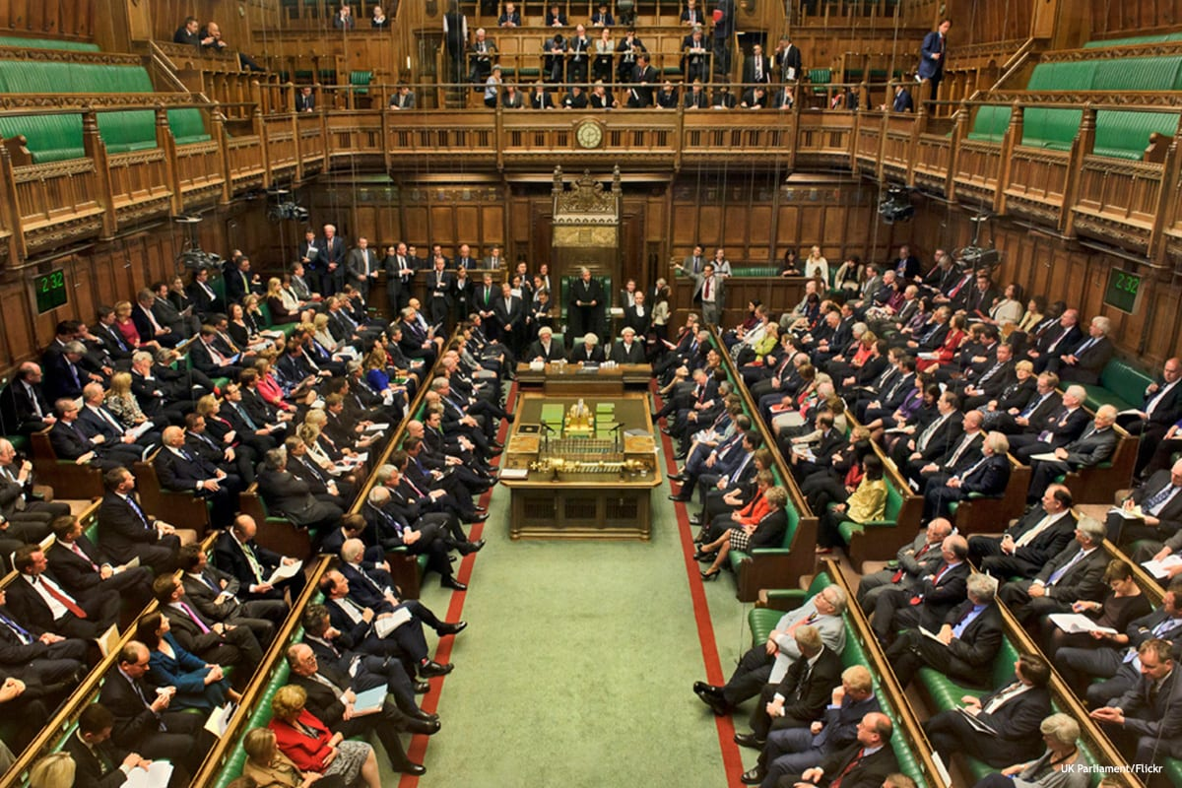

Slide 5
How do our tools (digital) change us?

Slide 6
The ART + TECH trap
Artists dealing with technology today are falling in the trap of accepting somebody else’s creativity as their limit and in this way, they are becoming advertisers for equipment. One possible reaction for an artist is to investigate the misusage of technology as a gesture of freedom, and in this way oppose the mainstream taste and expectations.
-Vuk Cosic (2002)

Slide 7
How to Code?
How to creatively* use Code?
* - Critical Perspective

Slide 8
Critical Perspectives on Computation
“The single most important thing you need in order to have a
career in the arts is persistence. The second most important
thing you need is talent. The third most important thing is a
grounding in how the online world works. Its that Important”
— Cory Doctorow
“Programming liberates art from being secondary to
commercial media”
- Lev Manovich

Slide 9
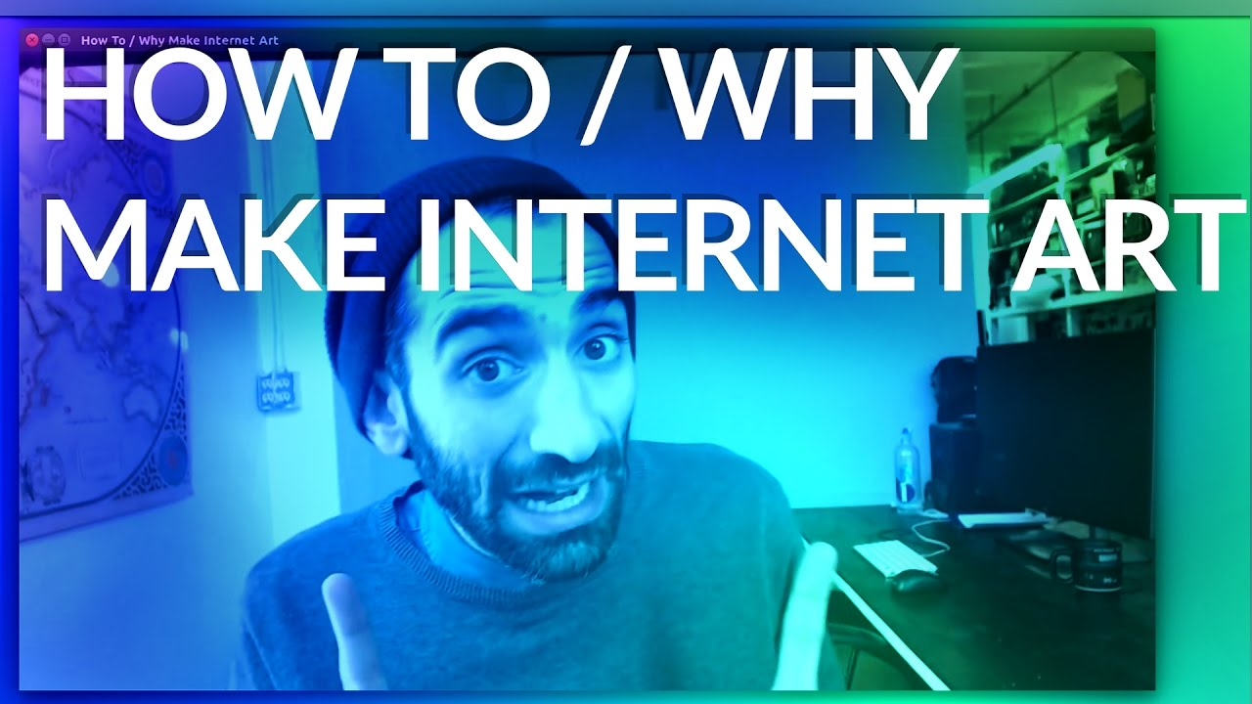
Why learn Internet Art?
https://www.youtube.com/watch?v=0DZ0wBjFKg4

Slide 10
The ART + TECH trap
Artists dealing with technology today are falling in the trap of accepting somebody else’s creativity as their limit and in this way, they are becoming advertisers for equipment. One possible reaction for an artist is to investigate the misusage of technology* as a gesture of freedom, and in this way oppose the mainstream taste and expectations.
-Vuk Cosic (2002)
*misusage of technology = Poetic, Political, Playful ….etc

Slide 11


Slide 12
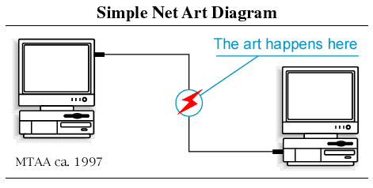
MTAA
https://anthology.rhizome.org/simple-net-art-diagram

Slide 13
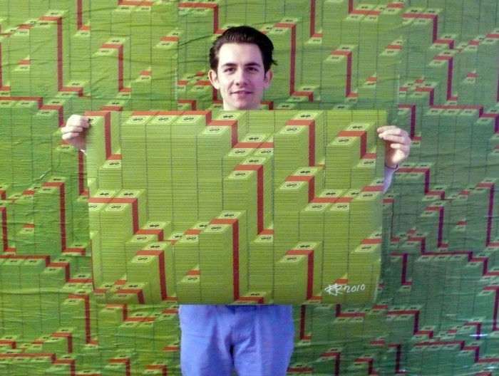
Rafaël Rozendaal
https://www.youtube.com/watch?v=q2PlTV-RvnE
https://www.newrafael.com/websites/

Slide 14
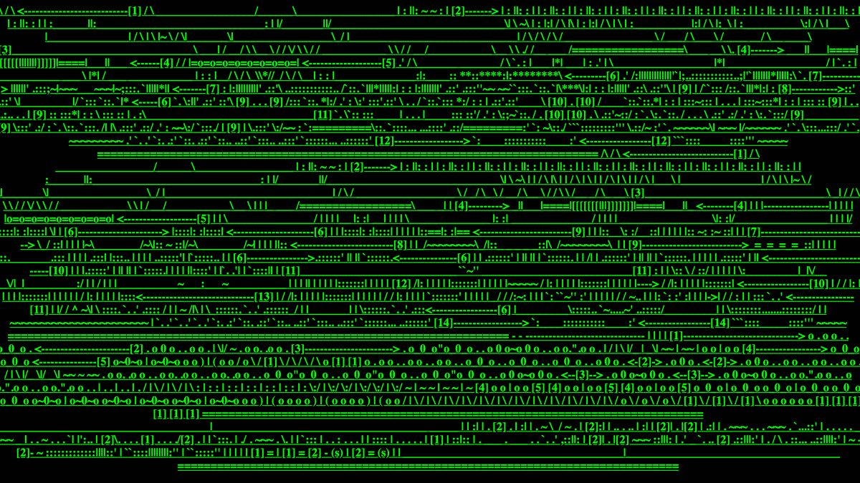
JODI -http://wwwwwwwww.jodi.org/

Slide 15
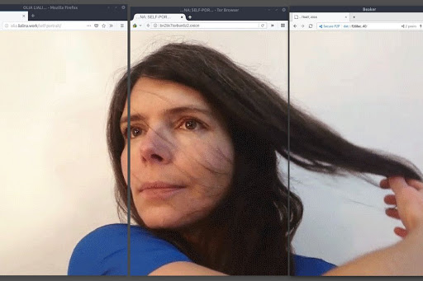
Olia Lialina
http://art.teleportacia.org/olia.html
https://www.artforum.com/video/olia-lialina-hosted-2020-82598

Slide 16
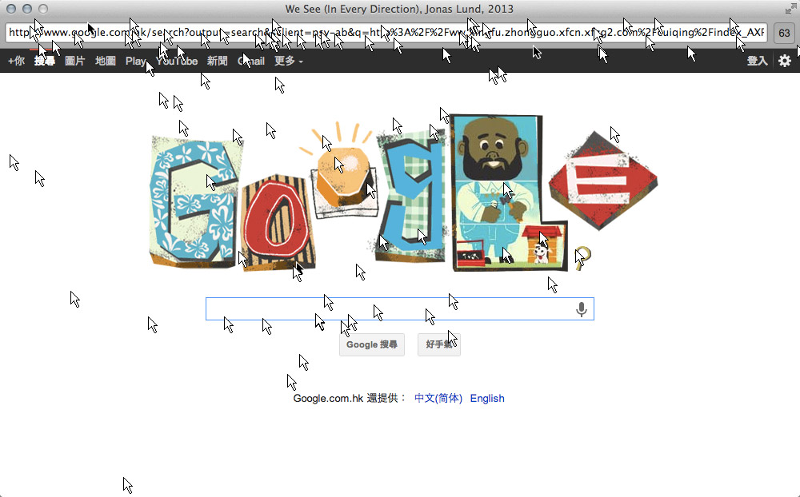
Jason Lund
https://jonaslund.com/works/we-see-in-every-direction/

Slide 17
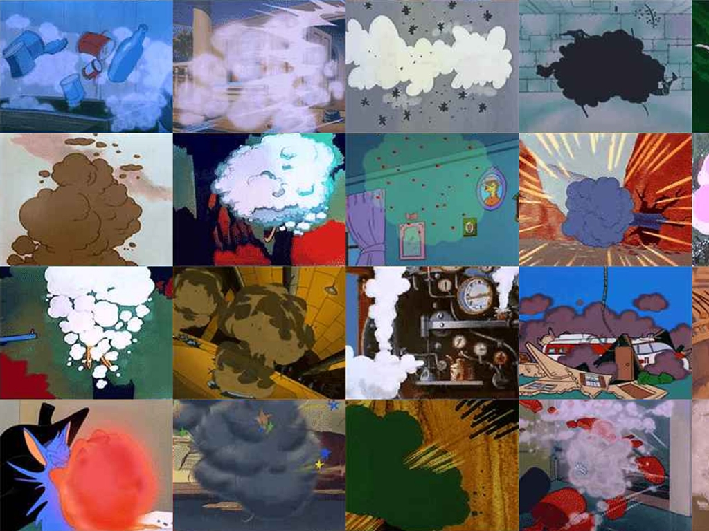
I’m Google by Dina Kelberman
Smoke & Fire: http://dinakelberman.com/smokeandfire/
https://dinakelberman.tumblr.com/

Slide 18
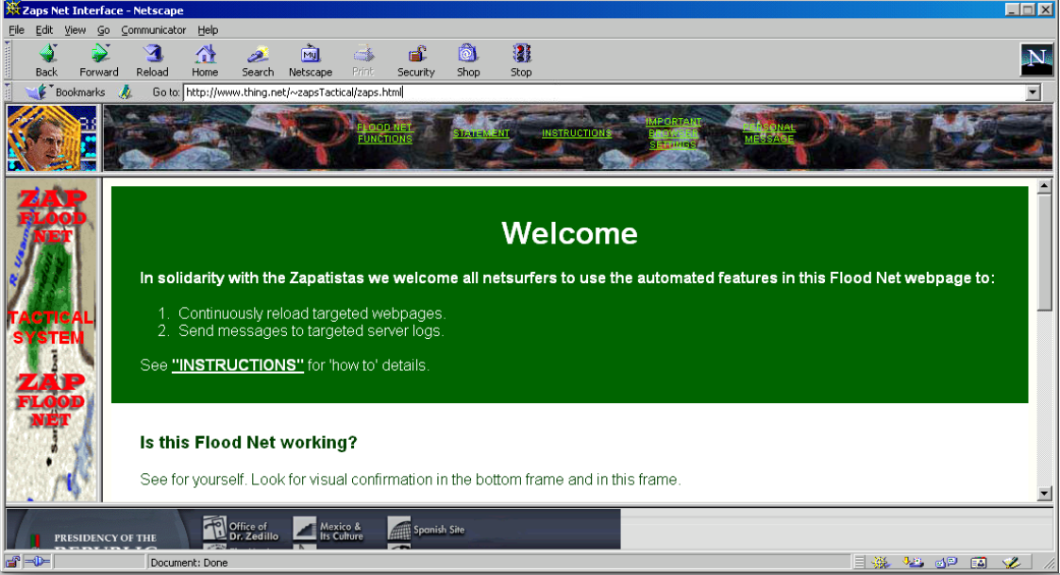
FloodNet - Electronic Disturbance Theater
https://anthology.rhizome.org/floodnet
Smoke & Fire: http://dinakelberman.com/smokeandfire/
https://dinakelberman.tumblr.com/

Slide 19
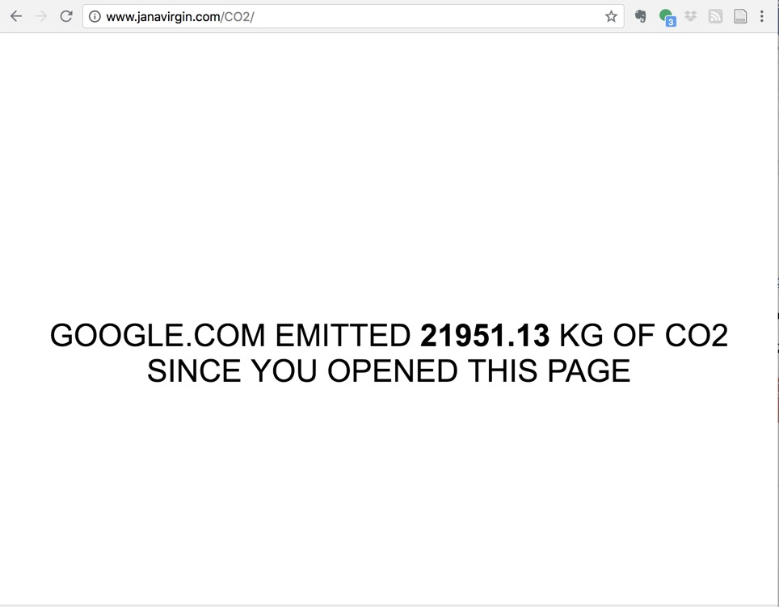
CO2GLE by Joanna Moll
http://www.janavirgin.com/CO2/
Smoke & Fire: http://dinakelberman.com/smokeandfire/
https://dinakelberman.tumblr.com/

Slide 20
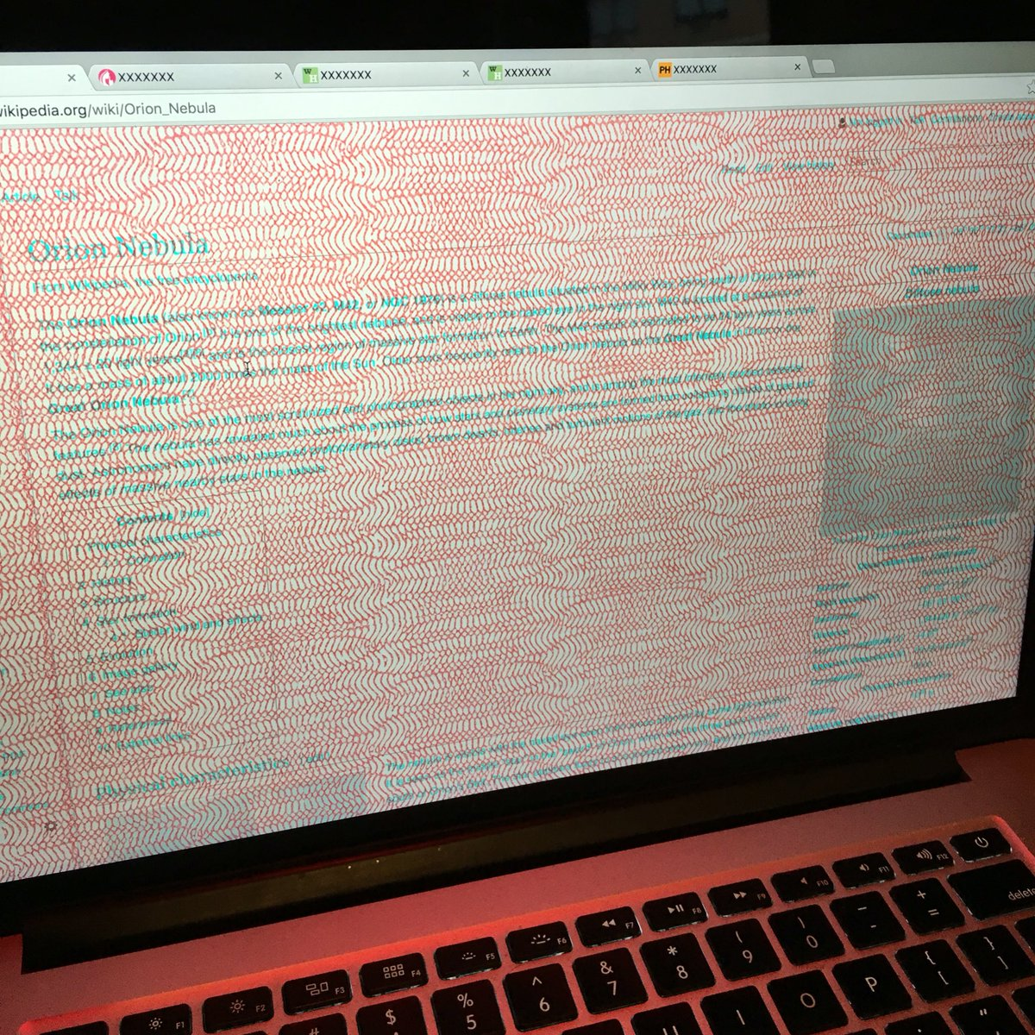
DECODELIA by Melanie Hoff
https://www.melaniehoff.com/DECODELIA/
Smoke & Fire: http://dinakelberman.com/smokeandfire/
https://dinakelberman.tumblr.com/

Slide 21
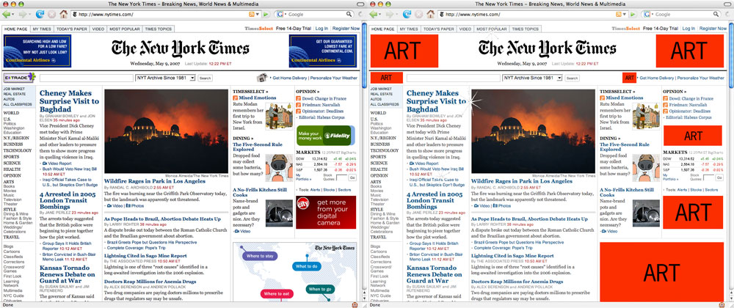
ADD ART by Steve Lambert
https://visitsteve.com/made/add-art-2-0/
Smoke & Fire: http://dinakelberman.com/smokeandfire/
https://dinakelberman.tumblr.com/

Slide 22
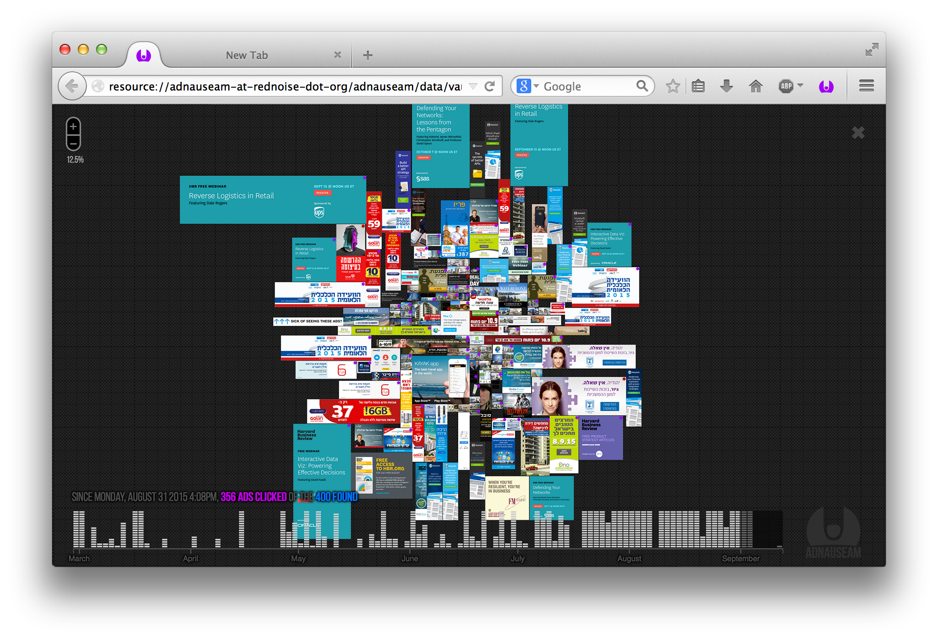
AdNauseum
https://adnauseam.io/
Smoke & Fire: http://dinakelberman.com/smokeandfire/
https://dinakelberman.tumblr.com/

Slide 23
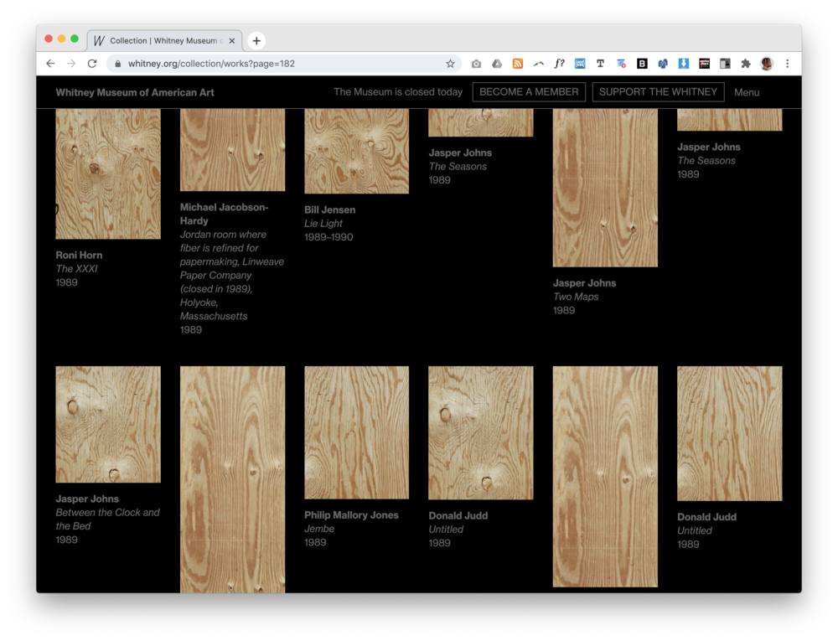
Looted by American Artist
https://americanartist.us/works/looted
Smoke & Fire: http://dinakelberman.com/smokeandfire/
https://dinakelberman.tumblr.com/

Slide 24
Web Art Residencies https://zkm.de/en/project/web-residencies
Smoke & Fire: http://dinakelberman.com/smokeandfire/
https://dinakelberman.tumblr.com/

Slide 25
Project 3: Hacking the Web
Smoke & Fire: http://dinakelberman.com/smokeandfire/
https://dinakelberman.tumblr.com/

